Slide 1
Multifidelity Aeroelastic Optimization: Bibliographic Study
Author:
Giovanni QUAGLIA
Supervisors:
Pr. Joseph MORLIER
Pdf. Joan MAS COLOMER
21/05/2019

Slide 2
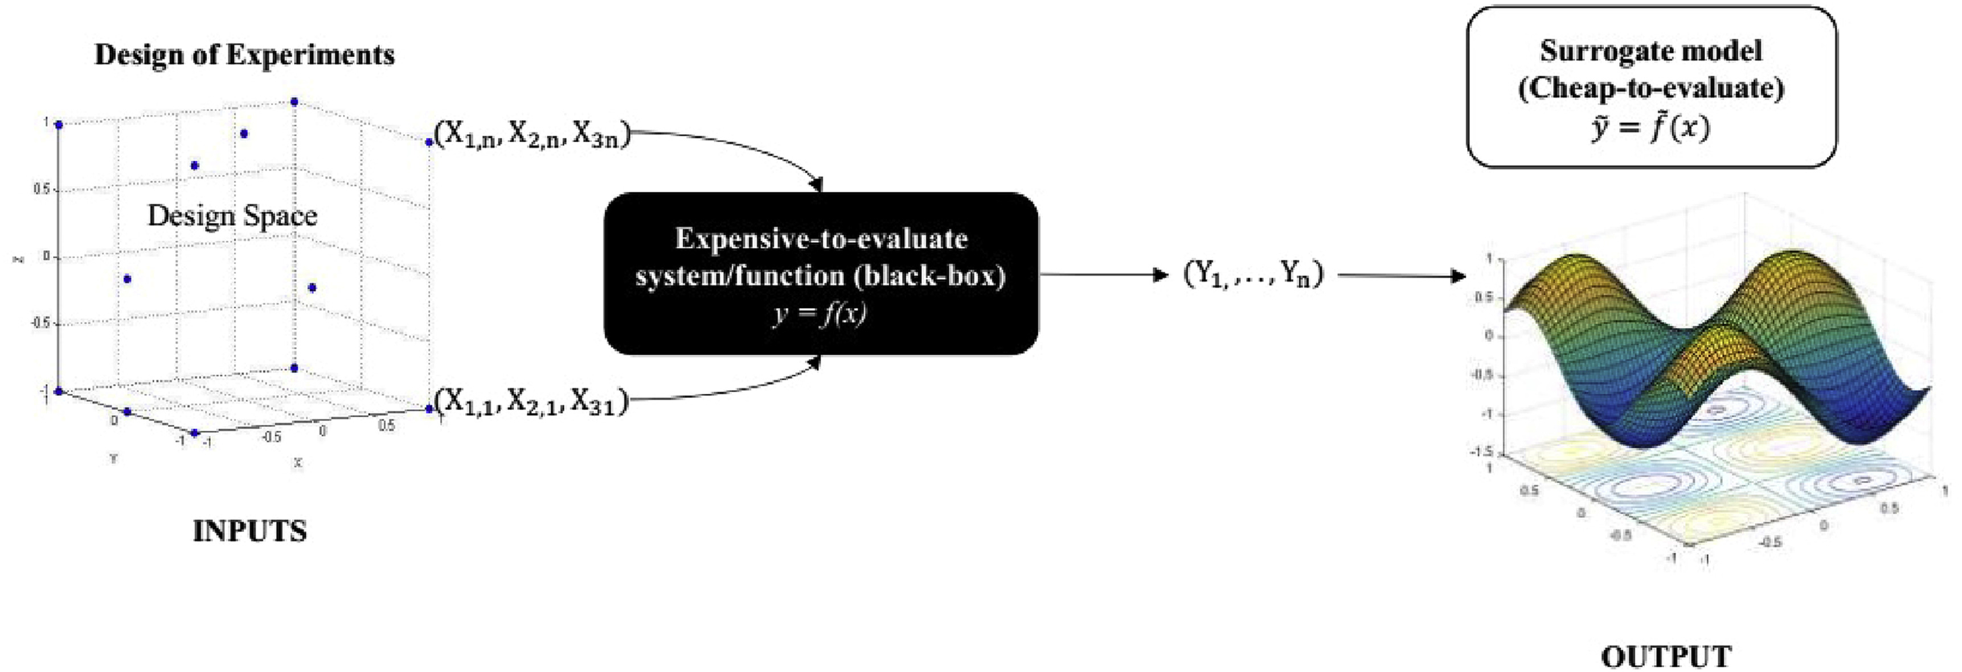
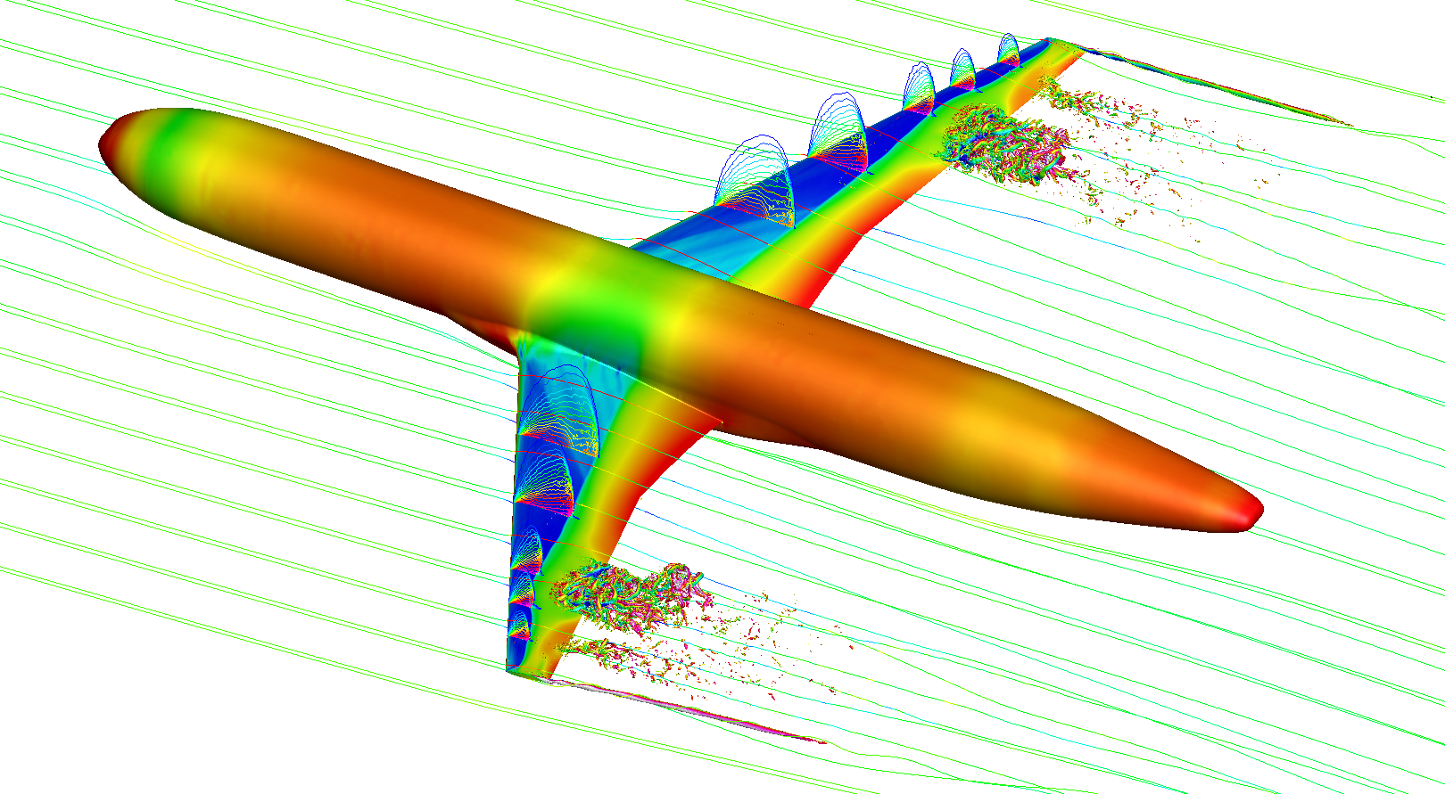
Context
The reduction of computational cost is a subject of major interest in aircraft design.
COMPLEX MODEL
[Yondo 2018]
Solution approaches: Multifidelity and Surrogate Models.

Slide 3
Summary
Black Box Aeroelastic Function
Multifidelity
Surrogate Models
Kriging
Co-Kriging
Optimization
SEGOMOE Framework
Future Work

Slide 4
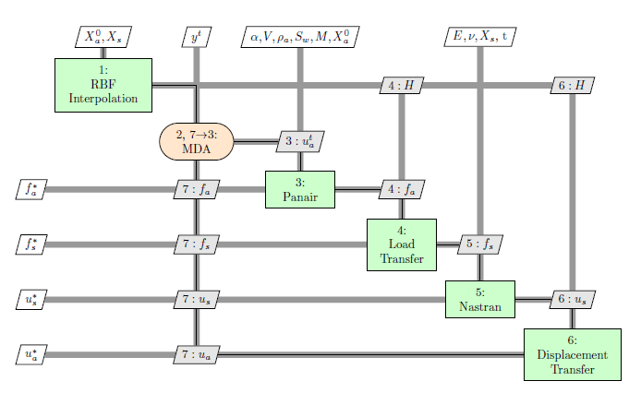
Black Box Aeroelastic Function
Fluid-Structure interaction problem is solved in an iterative partitioned approach.
Two separate aerodynamics and structural software are coupled together in a unique function.
[Colomer 2018]
OpenMDAO Model

Slide 5
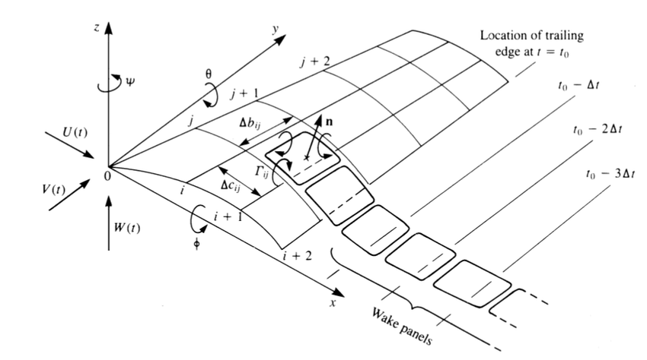
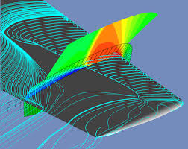
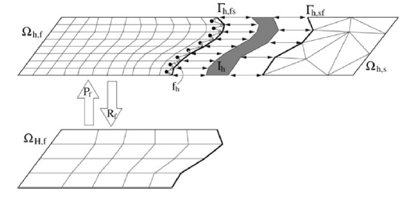
Multifidelity
The employment of functions with different accuracy and computational time can speed up the design process.
[Katz 2001]
Examples:
High and Low fidelity software
Relaxed convergence criterion
Various mesh resolutions
Experiments
[Onera]
[Scholcz, 2015]

Slide 6
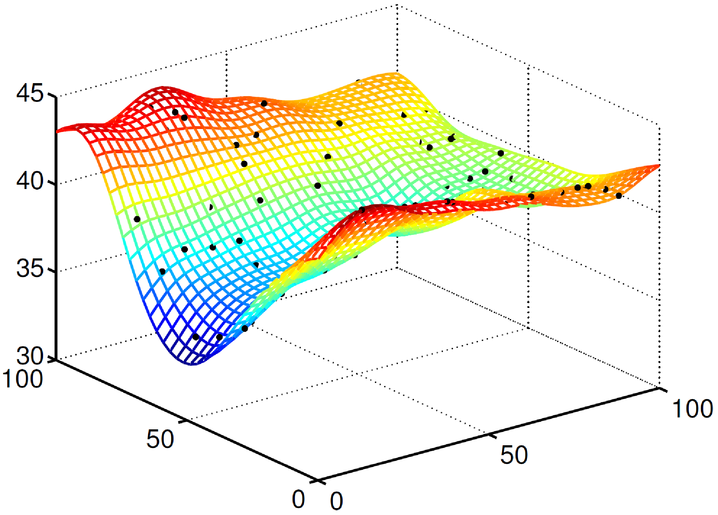
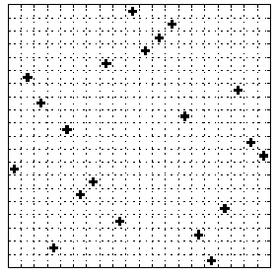
Surrogate Model
Computational cost is decreased analyzing a surrogate model of the real function.
[Forrester 2007]
[ETH]
DOE Sampling
Ex. LHS
Interpolation
Ex. Kriging, Co-Kriging

Slide 7
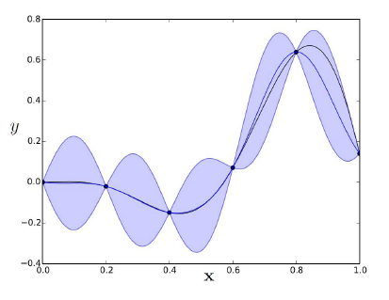
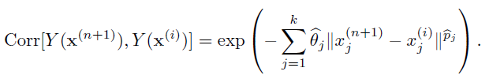
Surrogate Model
Kriging interpolation fits data to a Gaussian Process with constant mean and a defined covariance.
[Forrester 2007]
[Bartoli 2016]
Uncertainty on the prediction is zero in the sampled points and increases with distance.

Slide 8
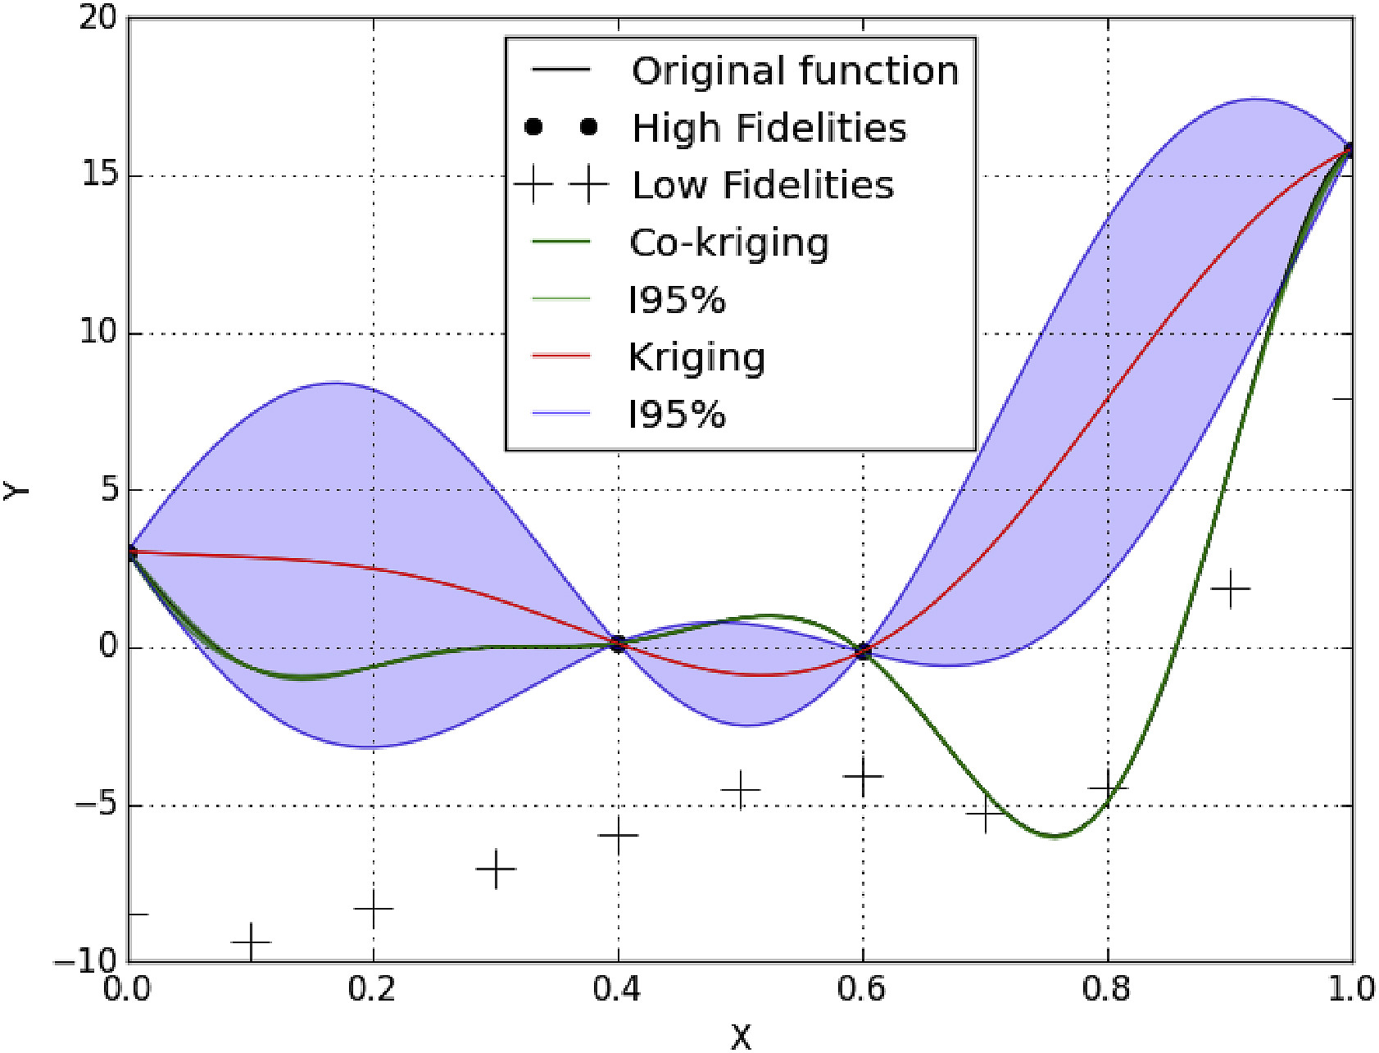
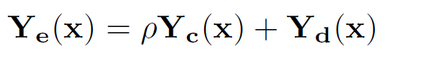
Surrogate Model
Co-Kriging interpolation takes into account data from two sources of different fidelity.
[Yondo 2018]
[Forrester 2007]
The prediction is based on the error between the High and Low Fidelity models.
Then a lower number of HF evaluations is required to build the surrogate model.

Slide 9
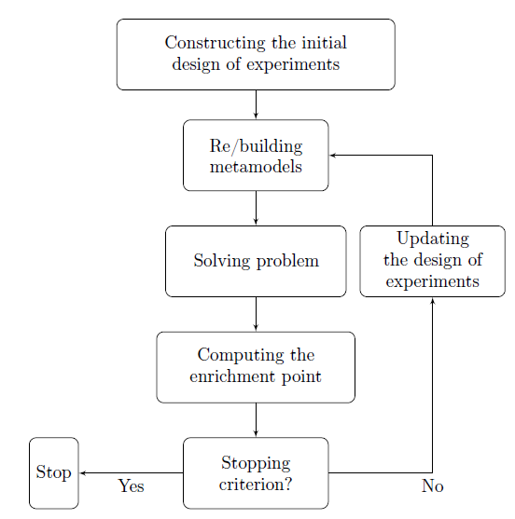
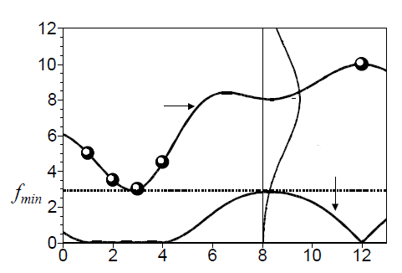
Optimization
Variable optimization can be performed on the surrogate model.
Probability
Prediction
Expected Improvement
[Jones 1998]
The optimum research balances exploration and exploitation considering the model uncertainty → Efficient Global Optimization (EGO)
[Bartoli 2016]

Slide 10
SEGOMOE Framework
ISAE Supaero and ONERA developed the SuperEGO Mixture of Experts (SEGOMOE) Framework in a joint project:
Multifidelity samples are clustered under different surrogate models (MFK, KPLS(-K), RBF, PA2, PA3, …)
Clusters are merged by a EM algorithm in a Gaussian Mixture Model
WB2 optimum criterion
[Bartoli 2016]

Slide 11
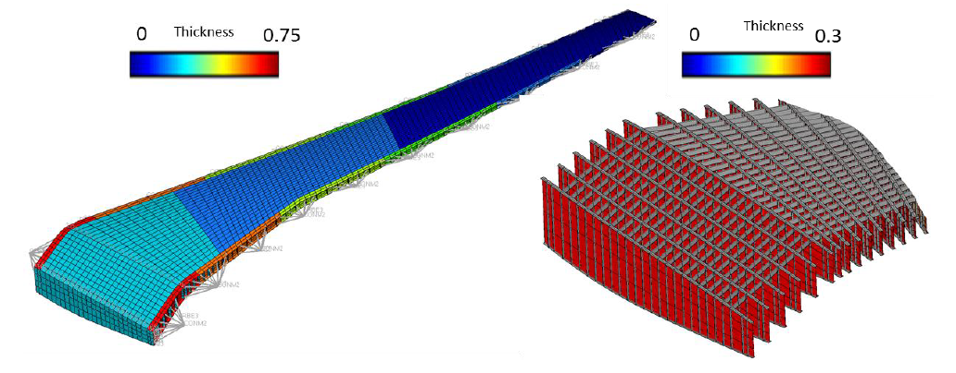
SEGOMOE Framework
The framework is currently tested on the NASA CRM concept.
[NASA CRM]
The structural model for the FEM analysis has still the same complexity in the HF and LF functions

Slide 12
Future Work
PIR Planning:
May
June
Bibliographic research
21 May: bibliographic presentation
Create a CRM Low fidelity structural model
Development of a more general structural simplification algorithm
PIR final presentation

Slide 13
References
[Bartoli et al., 2016] Bartoli, N., Kurek, I., Lafage, R., Lefebvre, T., Priem, R., Bouhlel, M. A.,
Morlier, J., Stilz, V., and Regis, R. (2016). Improvement of efficient global optimization with mixture of experts: methodology developments and preliminary results in aircraft wing design.
[Mas-Colomer, 2018] Mas-Colomer, J. (2018). Aeroelastic Similarity of a Flight Demonstrator via
Multidisciplinary Optimization. PhD thesis.
[Jones et al., 1998] Jones, D. R., Schonlau, M., and Welch, W. J. (1998). Efficient global optimization
of expensive black-box functions. Journal of Global Optimization, 13(4):455–492.
[Scholcz, 2015] Scholcz, T. (2015). Multi-fidelity methods for fluid-structure interaction and uncertainty
quantification.
[Jones, 2001] Jones, D. R. (2001). A taxonomy of global optimization methods based on response
surfaces. Journal of Global Optimization, 21(4):345–383.
[Forrester et al., 2007] Forrester, A. I., Sóbester, A., and Keane, A. J. (2007). Multi-fidelity optimization via surrogate modelling. Proceedings of the Royal Society A: Mathematical, Physical and Engineering Sciences, 463(2088):3251–3269.

Slide 14
References
[Yondo et al., 2018] Yondo, R., Andrés, E., and Valero, E. (2018). A review on design of experiments and surrogate models in aircraft real-time and many-query aerodynamic analyses. Progress in Aerospace Sciences, 96:23 – 61.
[ONERA] ONERA-M6 Wing, Star of CFD. https://www.onera.fr/en/news/onera-m6-wing-star-of-cfd. Accessed: 2019-05-11.
[Katz et al., 2001] Joseph Katz and Allen Plotkin. Low-speed aerodynamics, volume 13. Cambridge university press, 2001.
[ETH] Polynomial-Chaos-Kriging. http://www.sudret.ibk.ethz.ch/research/past-projects/polynomial-chaos-kriging.html. Accessed: 2019-05-11.
[NASA CRM] NASA Common Research Model, https://commonresearchmodel.larc.nasa.gov/files/2014/02/CRM_wingboxFEM_description_1.pdf, Accessed: 21/05/2019.

Slide 15
Thanks for your attention!
Any questions?

